Slide 1
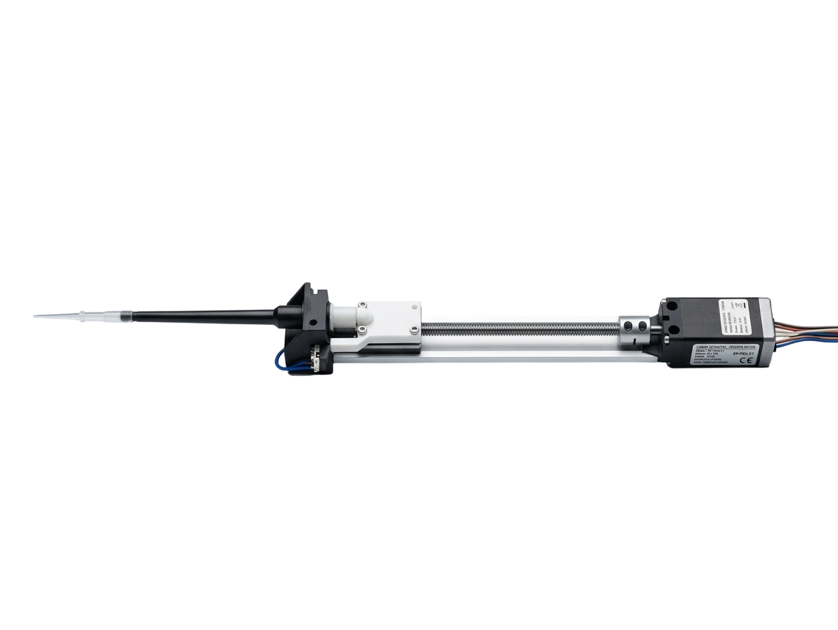
Fluidrop.
Wide Range Electronic Micropipette (1-100uL)
Kahaan Padiya
Optics and Microfluidics lab, IISc
2nd July 2026
Notes:
Hi everyone, my name is Kahaan, and for the past month I’ve been developing an electronic pippete, which I’m calling Fluidrop it’s a wide-range electronic micropipette designed to bridge the gap between handheld ergonomics and high-precision automated liquid handling

Slide 2
Agenda
Product overview
Calibration methodology (gravimetric + spectrophotometric)
Results: full-range accuracy
Results: 50 µL deep dive
Results: 10 µL deep dive
Practical application
Software showcase
Summary & conclusions
Notes:
Over the next few minutes, I’ll walk you through the core architecture of the device, how we built the hardware, and the rigorous gravimetric and spectrophotometric testing we used to prove its precision. Finally, I’ll show you the software ecosystem that drives it and where this technology can be applied in the real world.

Slide 3
Product Overview
Wide volume range:
    Replaces 3 traditional mechanical pipettes P10, P20 and P100 by having a functional range of 1-100uL.
Software controlled multipoint Calibration
    Actively corrects for mechanical non-linearities in real-time.
Efficient liquid handling modes:
    Variable Volume pipetting
    Aliquot mode
Closed loop hardware feedback:
    Physical limit switch architecture ensures a perfect mechanical "True Zero" on every cycle, eliminating cumulative error over hundreds of pipetting cycles.
Notes:
Fluidrop uses software-controlled, multi-point calibration to actively correct for mechanical non-linearities in real-time. This allows for advanced liquid handling modes, like automated aliquoting, all while utilizing a physical limit switch to guarantee a perfect 'True Zero' on every single dispense cycle.

Slide 4
System architecture and mechanics
Notes:
Let’s take a look under the hood to understand how it works

Slide 5
System architecture and mechanics
Stepper Motor Drivetrain
Role: High-Torque, Quantized Volumetric Control
Provides discrete, digitally controllable rotational steps for exact volumetric tracking without relying on analog spring-tension feedback.
Notes:
We are using a nema 11 stepper motor which provides discrete digitally controllable steps for exact volumetric tracking and totally eliminates the human error and fatigue associated with manual pipetting.

Slide 6
System architecture and mechanics
Lead-Screw Precision Mechanism
Role: High-Resolution Rotary-to-Linear Translation
Acts as a mechanical gear reduction converting large, stepper rotations into micro scale, high torque linear piston movements.
The fine thread pitch of the screw allows for sub-microliter resolution, allowing the device to accurately dispense volumes of single microliter.
Notes:
That rotational energy is converted into linear motion via a precision lead-screw mechanism and the guide rail prevent any lateral wobble which can cause non linear dispensing. The extremely fine thread pitch acts as a mechanical gear reduction giving us the resolution needed to dispense single microliter volumes

Slide 7
System architecture and mechanics
Air Displacement / Negative Pressure System
Role: Non-Contact aspiration
Integrates the lower half of an industry-standard, commercial mechanical pipette.
Notes:
For the fluidics, we utilized an air-displacement, negative pressure system by integrating the lower half of an industry-standard commercial pipette. This means the liquid never touches the internal mechanics—preventing contamination—while guaranteeing universal compatibility with standard laboratory pipette tips.

Slide 8
Calibration Methodology
Method 1: Multi point gravimetric calibration (weighing dispensed volumes across the full range)
Purpose: Establishes absolute accuracy and linearity across the entire 1–100 µL dynamic range.
Equipment: Mettler Toledo analytical balance (0.1 mg resolution).
Process: Iterative weighing of dispensed water at 10 distinct volume setpoints. Data was used to map mechanical non-linearities and generate the firmware's multi-point correction curve
Method 2: Spectrophotometric dye-dilution (absorbance at 665 nm as a proxy for volume CV)
Purpose: Validates mechanical precision (repeatability) independent of scale-resolution limits.
Equipment: DeNovix spectrophotometer.
Process: Dispensing Methylene Blue solution aliquots (10 µL and 50 µL) into a fixed diluent. Peak absorbance at 661 nm was used to calculate the Coefficient of Variation (CV%) of dispensed volume.
Notes:
we validated it using two independent testing methodologies. Method 1 was a multi-point gravimetric calibration using a high-resolution Mettler Toledo balance. We weighed dispensed water at 10 distinct volumes to map out the mechanical non-linearities and generate our firmware's correction curve. Method 2 was spectrophotometric dye-dilution, where we measured the absorbance of Methylene Blue at 661 nanometers. This allowed us to measure the true mechanical repeatability of the device, completely independent of the scale's resolution limits."

Slide 9
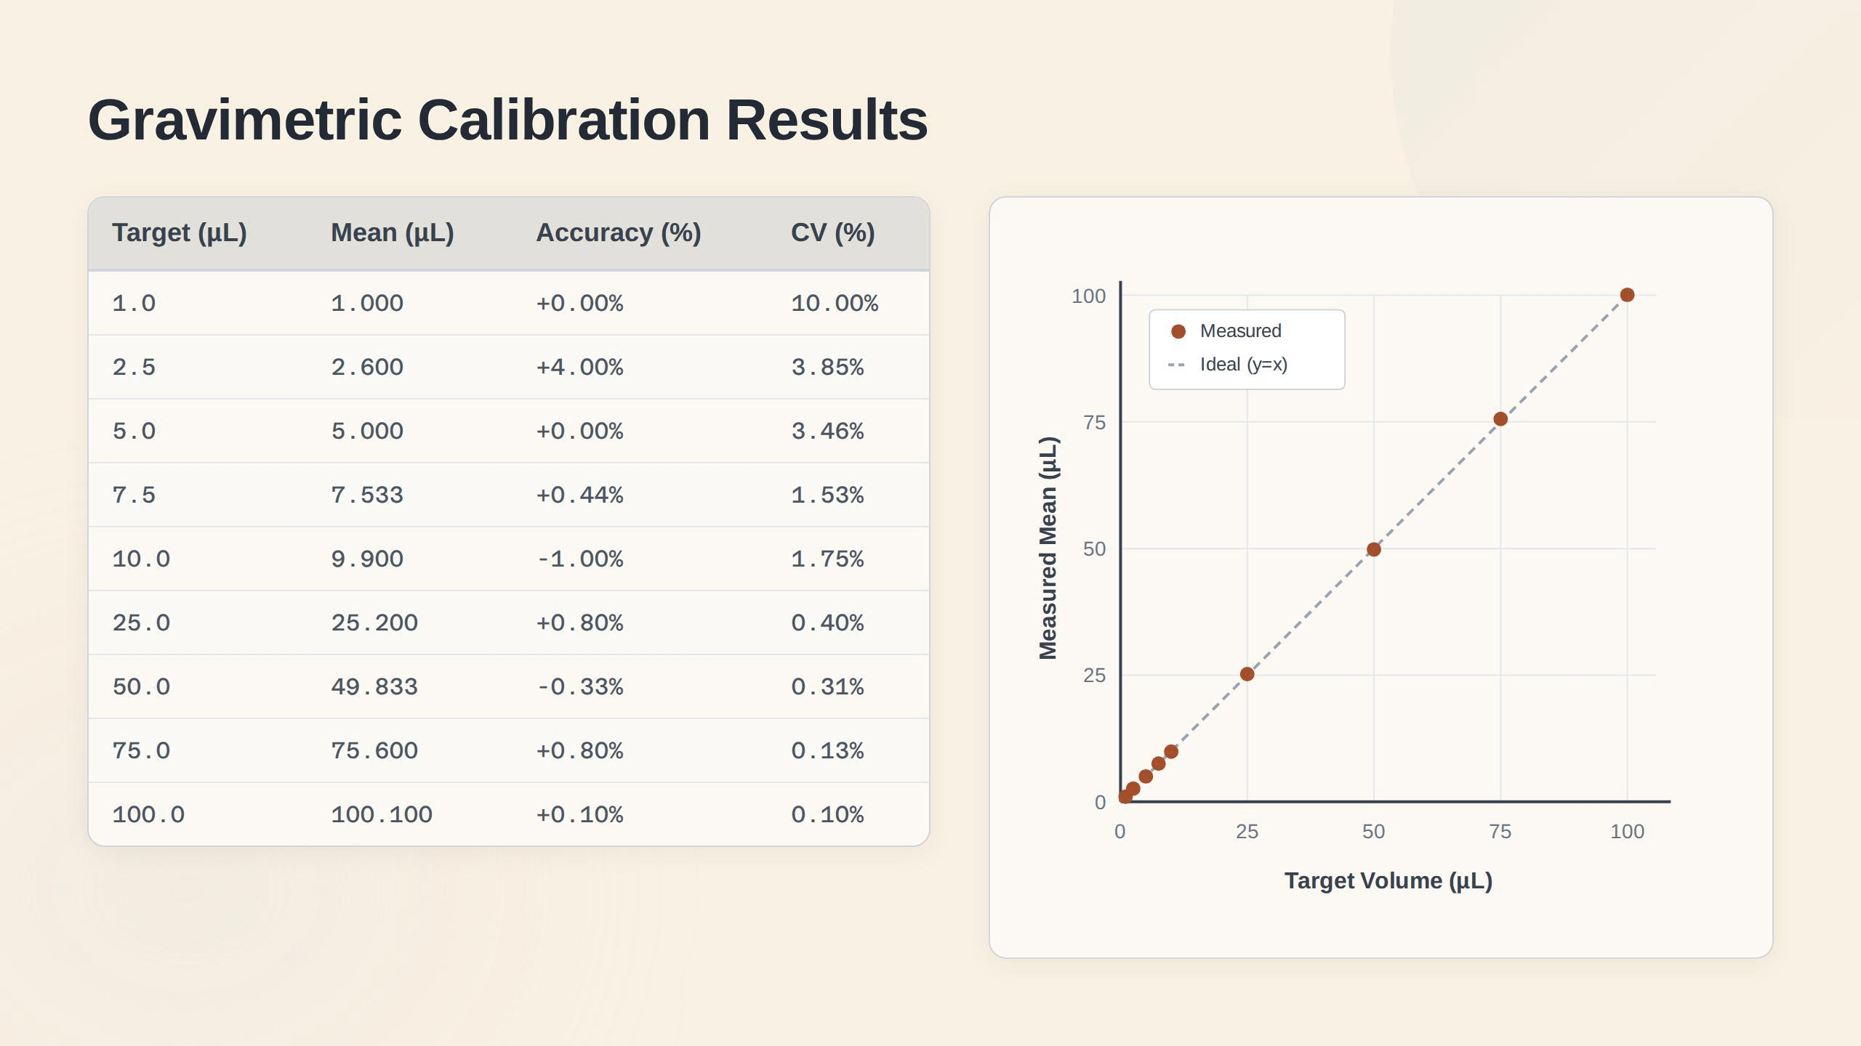
Method 1: Multi point gravimetric calibration (weighing dispensed volumes across the full range)
Purpose: Establishes absolute accuracy and linearity across the entire 1–100 µL dynamic range.
Equipment: Mettler Toledo analytical balance (0.1 mg resolution).
Process: Iterative weighing of dispensed water at 10 distinct volume setpoints. Data was used to map mechanical non-linearities and generate the firmware's multi-point correction curve
Method 2: Spectrophotometric dye-dilution (absorbance at 665 nm as a proxy for volume CV)
Purpose: Validates mechanical precision (repeatability) independent of scale-resolution limits.
Equipment: DeNovix spectrophotometer.
Process: Dispensing Methylene Blue solution aliquots (10 µL and 50 µL) into a fixed diluent. Peak absorbance at 665 nm was used to calculate the Coefficient of Variation (CV%) of dispensed volume.
Notes:
Looking at the gravimetric results, you can see the success of our multi-point correction curve. On the right, the measured volumes track almost perfectly across the ideal 1:1 line. Across the entire 1 to 100 microliter range, we achieved exceptional accuracy, with our 50 microliter test showing an systemic error of minus 0.33% and a coefficient of variation of just 0.31%.

Slide 10
Spectrophotometric Dye-Dilution Analysis
Using dye-dilution and measuring absorbance at 661 nm, the %CV in absorbance acts as a direct proxy for the %CV in volume.
The following slides detail the performance breakdown at 50uL and 10uL.
Notes:
Because micro-analytical scales struggle with environmental noise at very low volumes, we turned to dye-dilution to prove the system's mechanical variance. Since absorbance is directly proportional to the volume of dye dispensed, the CV of the absorbance acts as a direct proxy for the CV of our volume

Slide 11
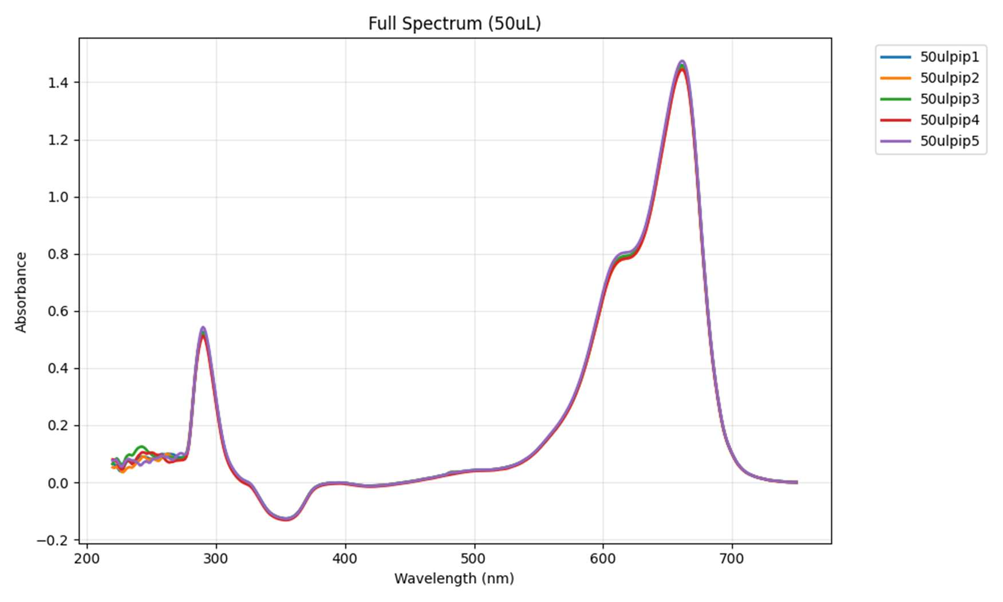
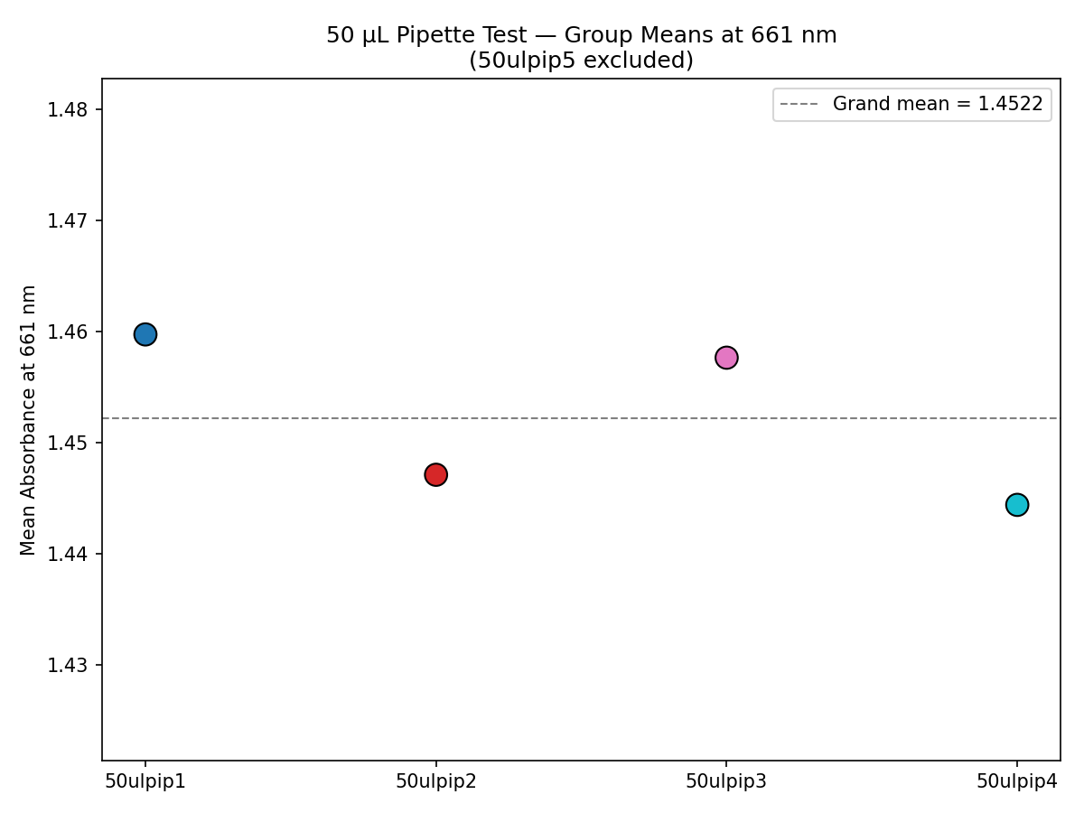
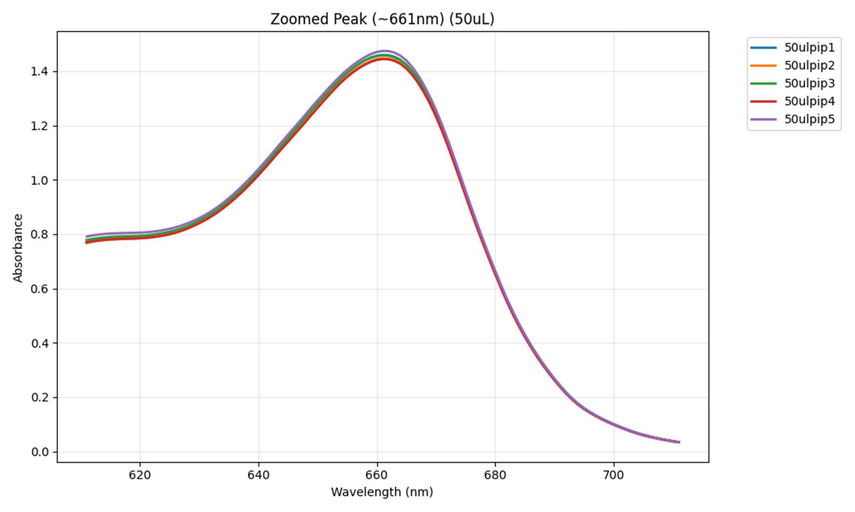
Spectrophotometric Dye-Dilution Analysis – 50uL Performance
Metric | CV% | Volume SD (50uL) | Volume Varience
Instrument repeatability | 0.37% | 0.19uL | 0.034 µL²
Pipette Variation | 0.59% | 0.29 µL | 0.086 µL²
Notes:
At 50 microliters, the results were incredibly stable. The instrument repeatability itself had a variance of 0.034 and the pipette variation was highly comparable at 0.086. What this means in practical terms is a standard deviation of just 0.29 microliters. The pipette reliably delivers 50 plus-or-minus 0.29 microliters every time.

Slide 12
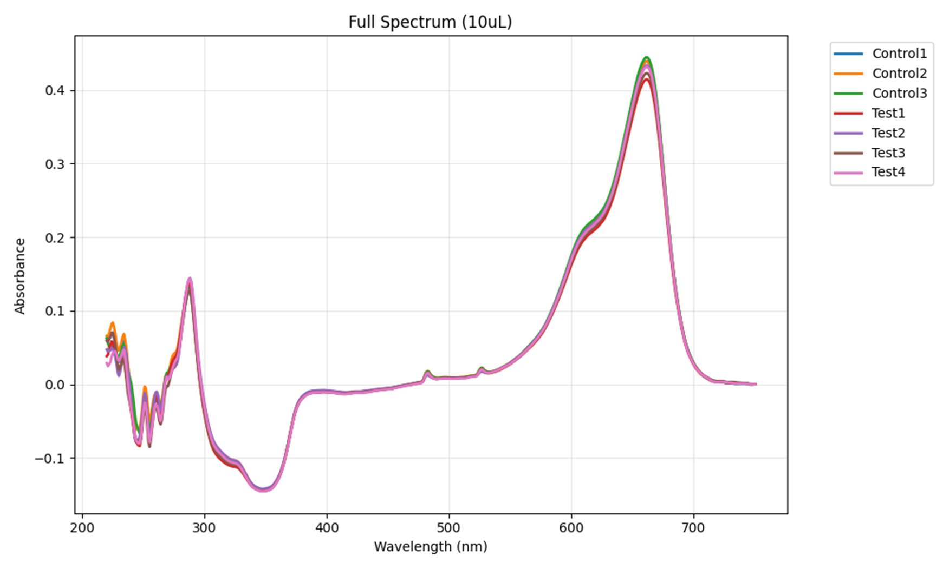
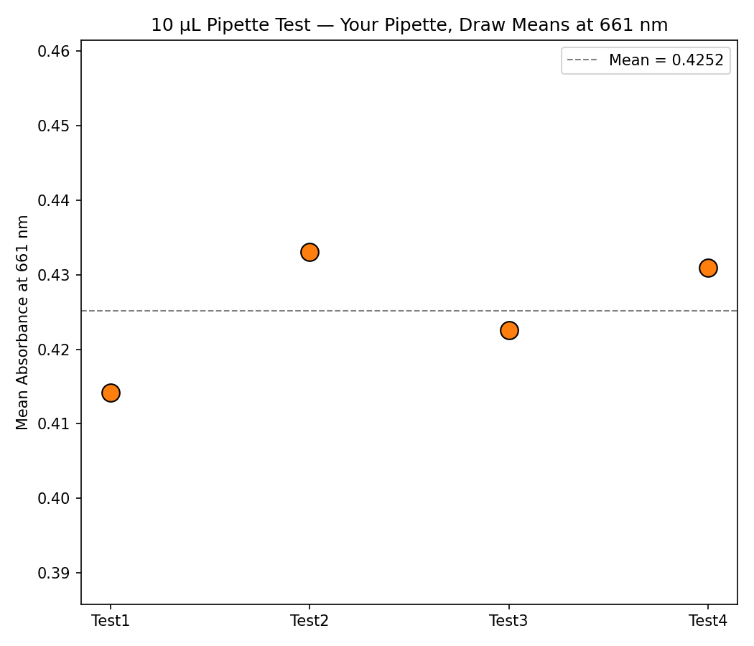
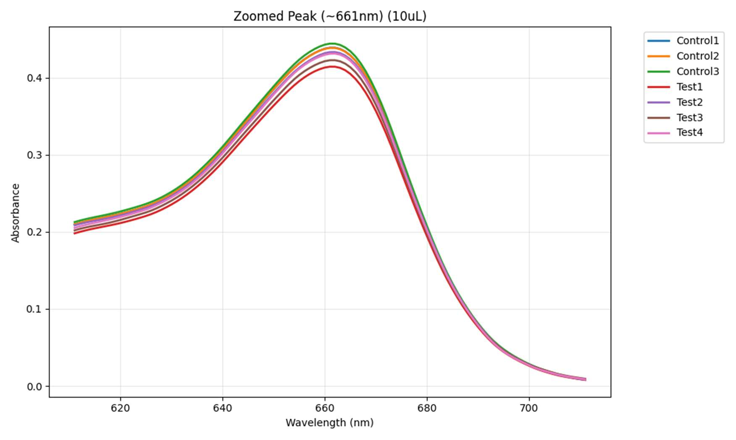
Spectrophotometric Dye-Dilution Analysis – 10uL Performance
Metric | CV% | Volume SD (50uL) | Volume Varience
Instrument repeatability | 0.37% | 0.19uL | 0.034 µL²
Pipette Variation | 2.09% | 0.21uL | 0.043µL²

Slide 13
Practical Application
The Handheld E-Pipette
Fully Automated Liquid Handling
Skill Independent: Eliminates user to user variability.
Error Reduction: Pre-programmed modes (like Aliquot) remove the need for mental math and repetitive manual volume adjustments
Injury & Fatigue Prevention: Replaces high tension thumb springs with a single electronic button push. This prevents Repetitive Strain Injuries (RSI) and thumb fatigue during long-duration, high-throughput microplate workflows.
Modular Robotics Integration:
As the pipette is self-contained and controlled via a simple Serial API, it can easily be mounted to an automated Cartesian (XY/XYZ) system for robotic dispensing
Automated ELISA Workflow
Automated Ultrafast PCR
Notes:
It serves two major roles. First, as a handheld e-pipette, it completely eliminates operator-to-operator variability and prevents repetitive strain injuries during long microplate workflows. Second, because it is self-contained and controlled via a Serial API, it can be seamlessly mounted onto a Cartesian XY gantry to act as the dispensing head for fully automated ELISA prep for Pramaan project, and Ultrafast PCR

Slide 14
Practical Application
The Handheld E-Pipette

Slide 15
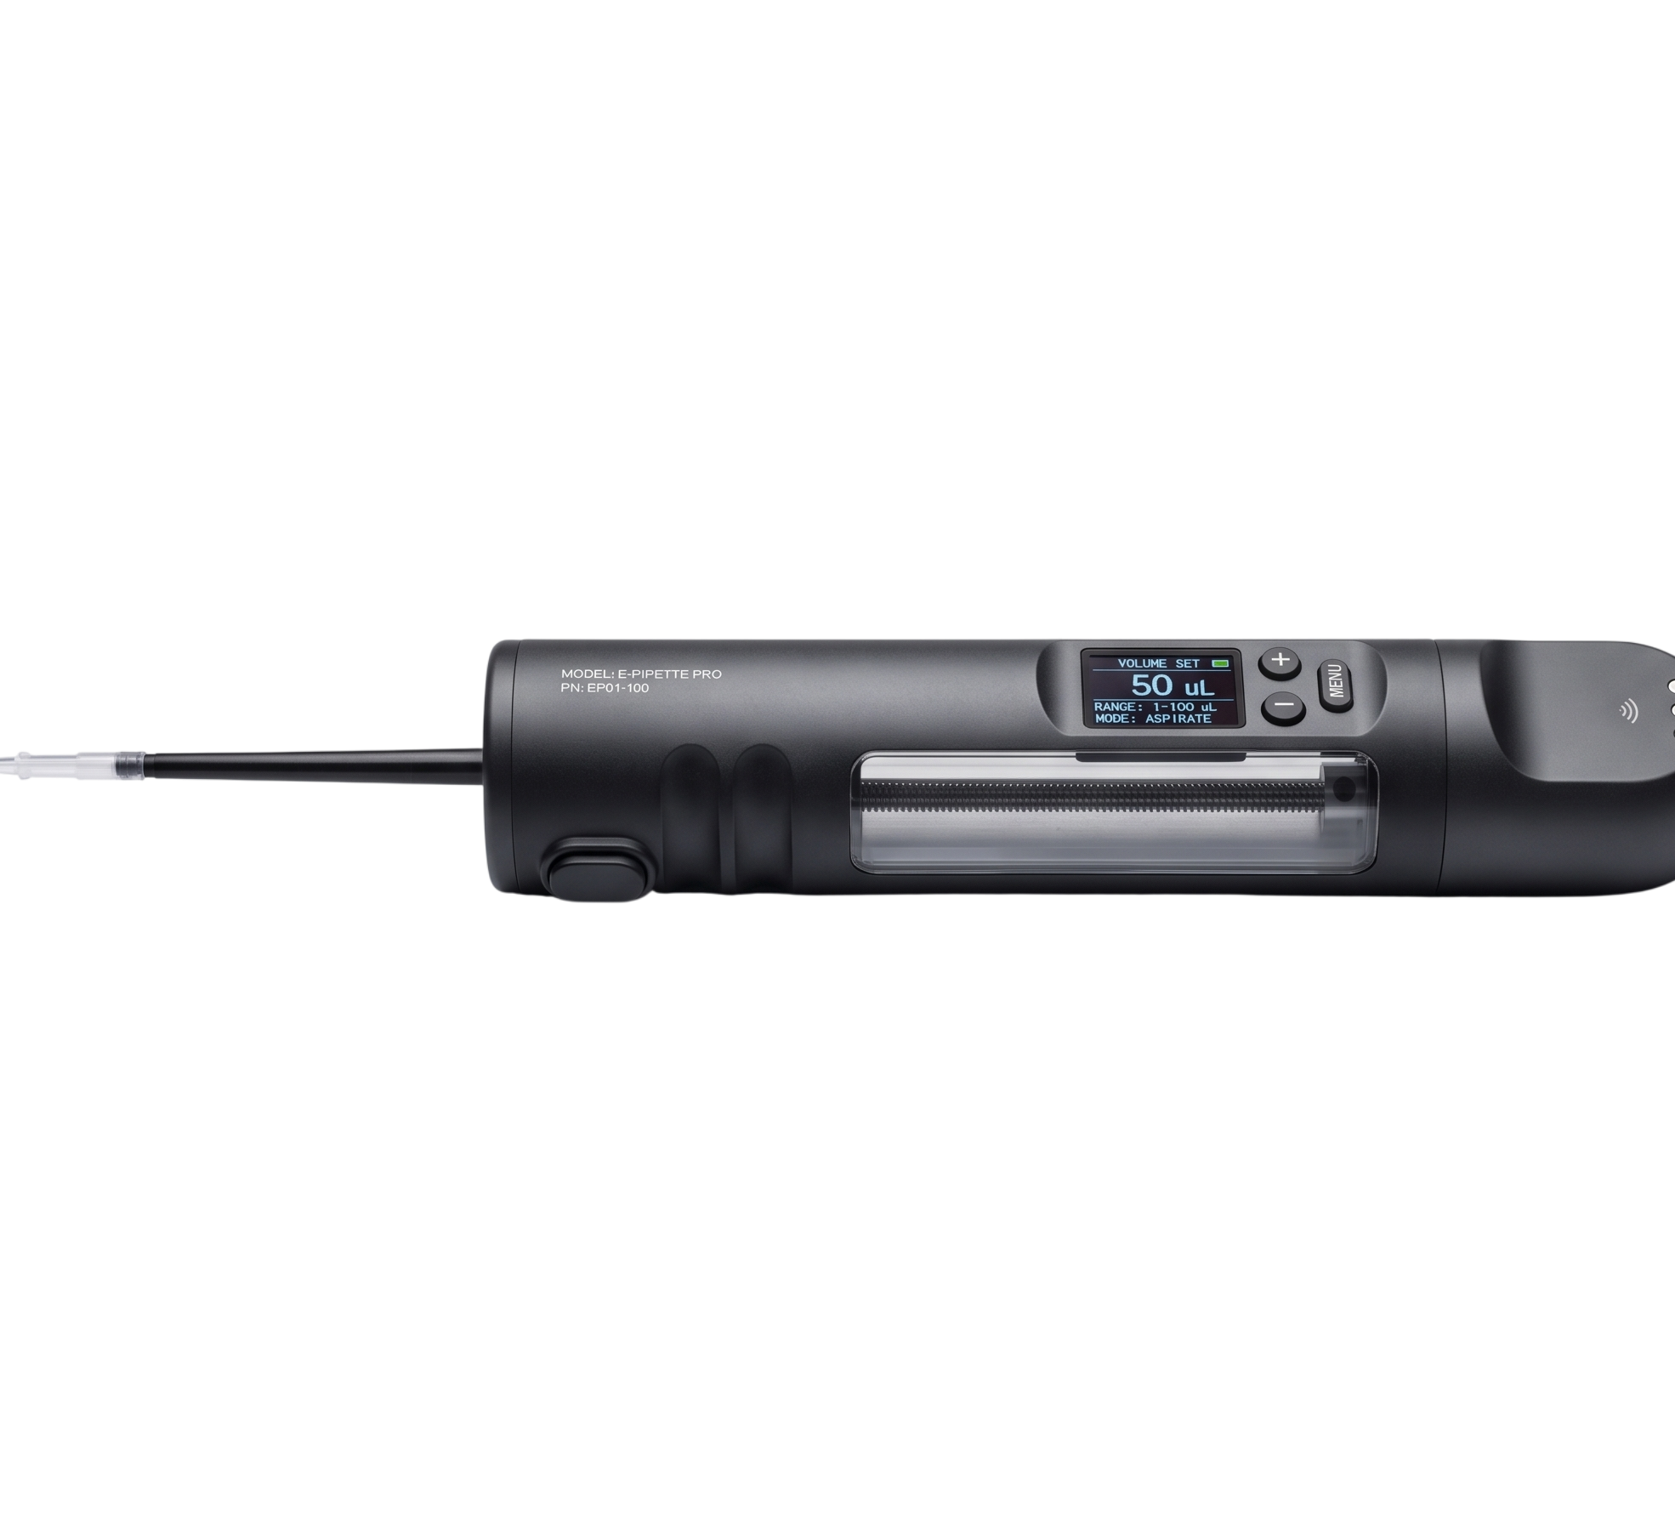
Practical Application
The Handheld E-Pipette
*illustrated with Generative AI
Notes:
the raw linear actuator can easily be housed in a sleek, ergonomic commercial casing, complete with an OLED display and tactile buttons for standalone handheld use.

Slide 16
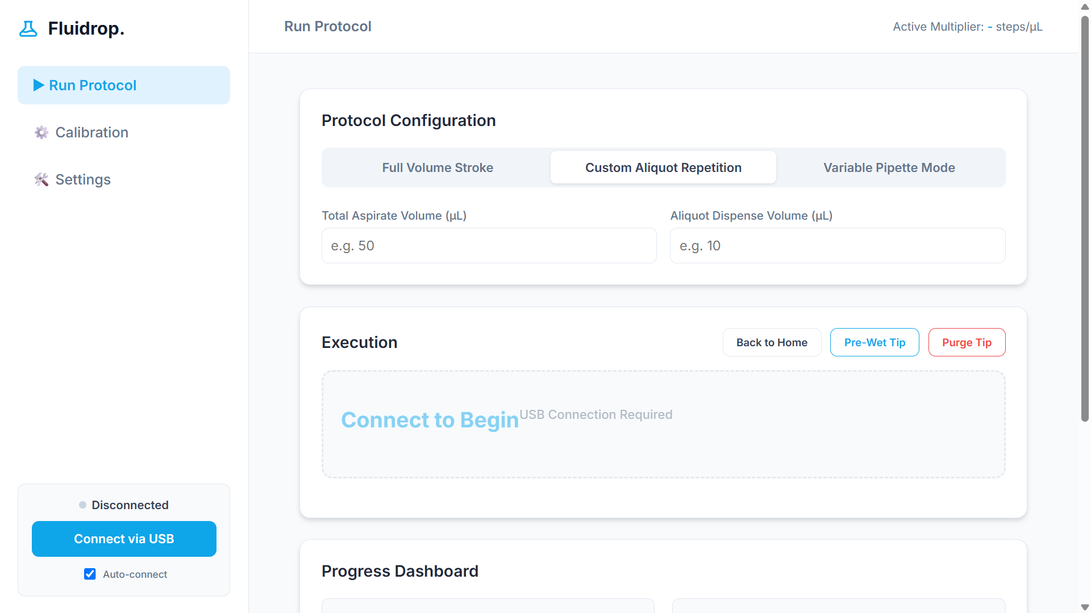
Device Dashboard
Notes:
We built a custom Web-Serial dashboard that connects directly to the pipette from any Chrome browser. From here, users can configure protocols like Aliquot modes, jog the motor to set hard limits, and dynamically input their gravimetric data to generate the multi-point calibration curve. The software automatically flashes this curve into the pipette's onboard memory, meaning the device runs perfectly autonomously once unplugged.

Slide 17
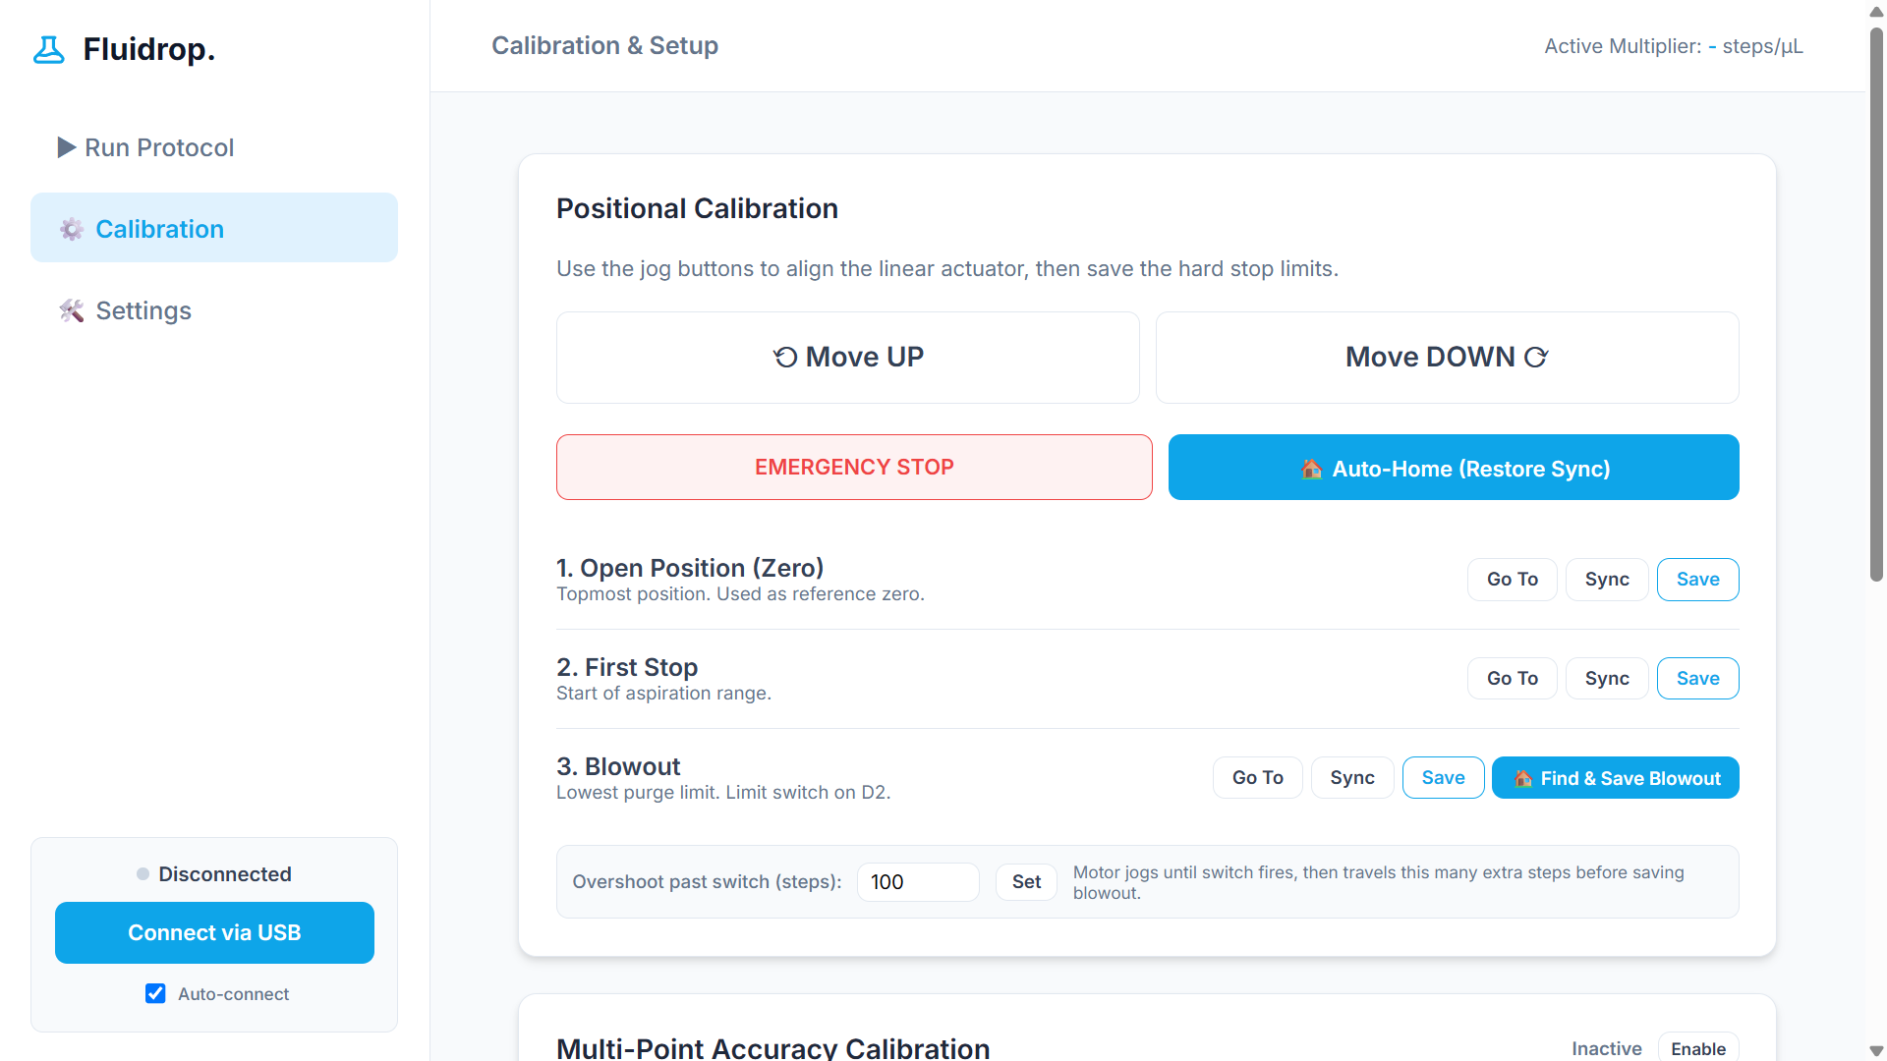
Device Dashboard

Slide 18
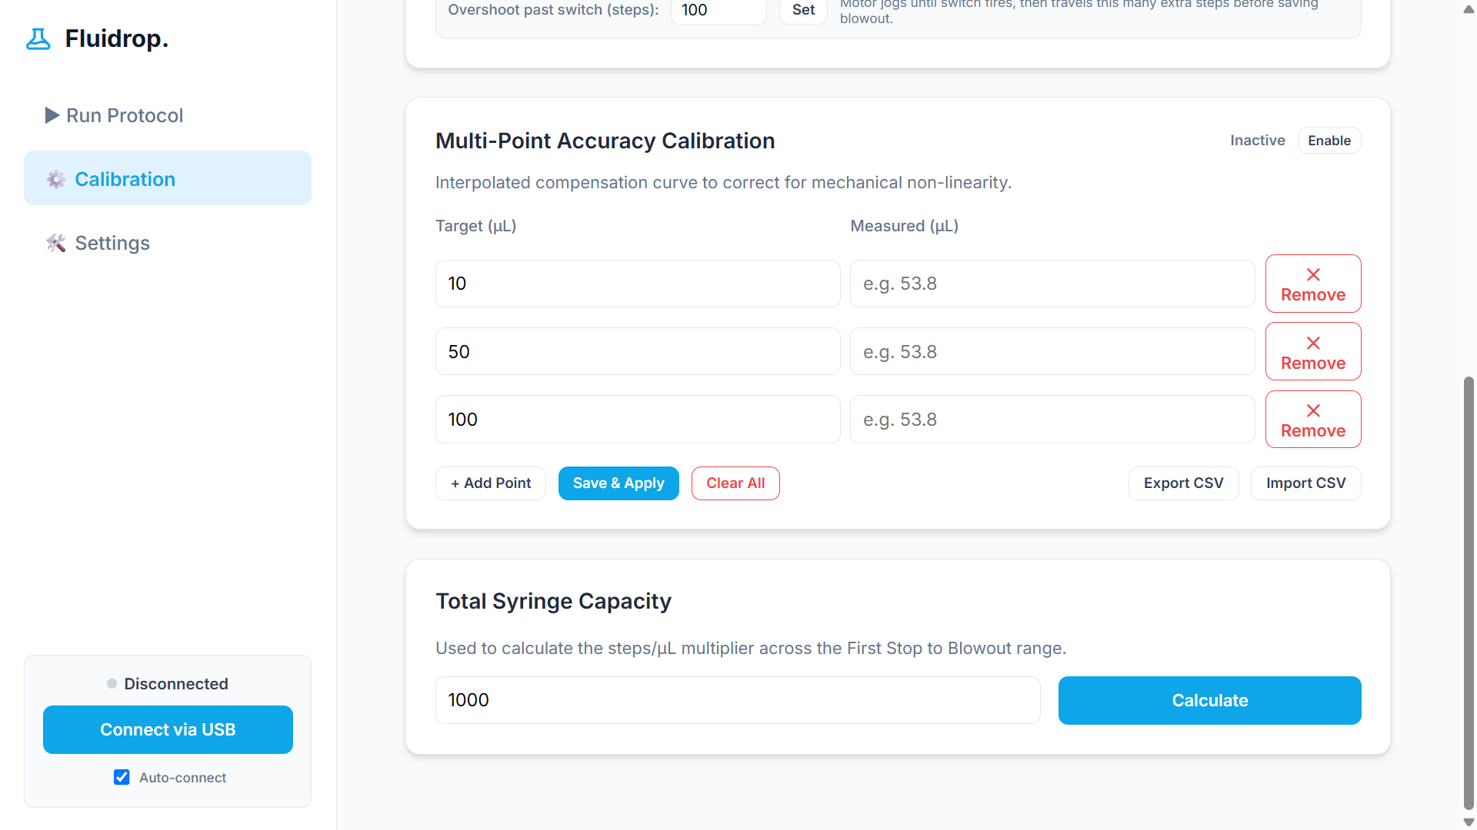
Device Dashboard

Slide 19
Conclusion
This project demonstrates a functional, wide range electronic pipette (1-100 µL) that achieves high precision through software based calibration, offering an ergonomic alternative to manual pipetting with potential for integration into automated liquid-handling systems, and efficient dispensing features like aliquot and programmed dispensing.
Notes:
In conclusion, we successfully engineered a 1-to-100 microliter electronic pipette that replaces three manual instruments. By pairing a high-resolution linear actuator with dynamic software calibration, we achieved high precision while eliminating human fatigue. Fluidrop is not just a motorized syringe—it is a smart, autonomous liquid handling platform ready to scale from the scientist's hand directly into robotic automation. Thank you, and I’ll now take any questions."

